Slide 1
Weeks 11&12 Exercise
Andrea Fox
DSC640 – T301 Data Presentation & Visualization

Slide 2
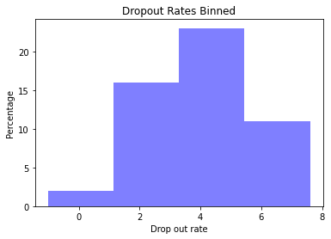
Python - Histogram

Slide 3
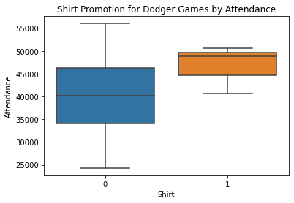
Python – Box plot

Slide 4

Python – Bullet Chart

Slide 5
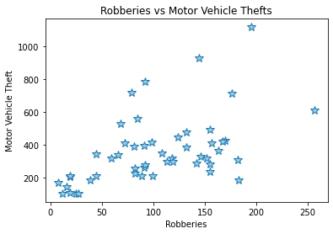
Python – My choice – Scatter Plot

Slide 6
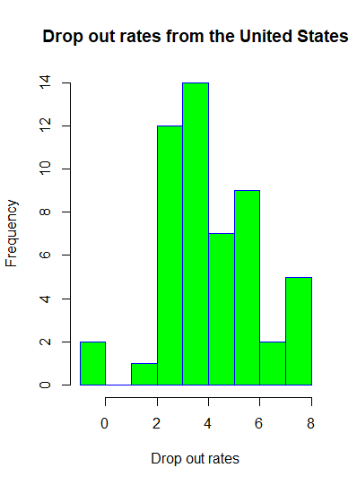
R - Histogram

Slide 7
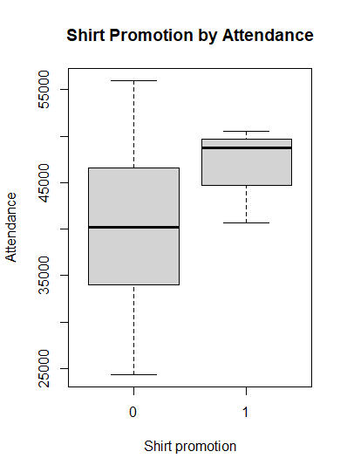
R - Boxplot

Slide 8
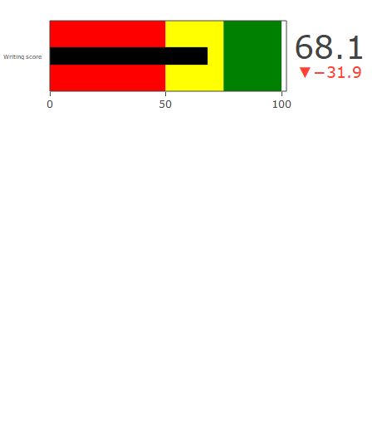
R – Bullet chart
Had a lot of trouble getting this to work correctly. This was the best I was able to get.

Slide 9
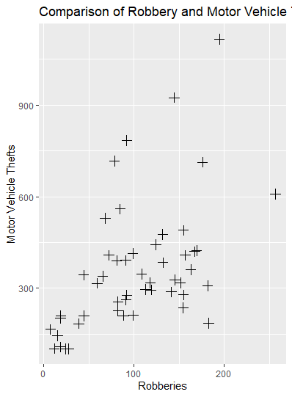
R – My Choice – Scatter plot

Slide 10
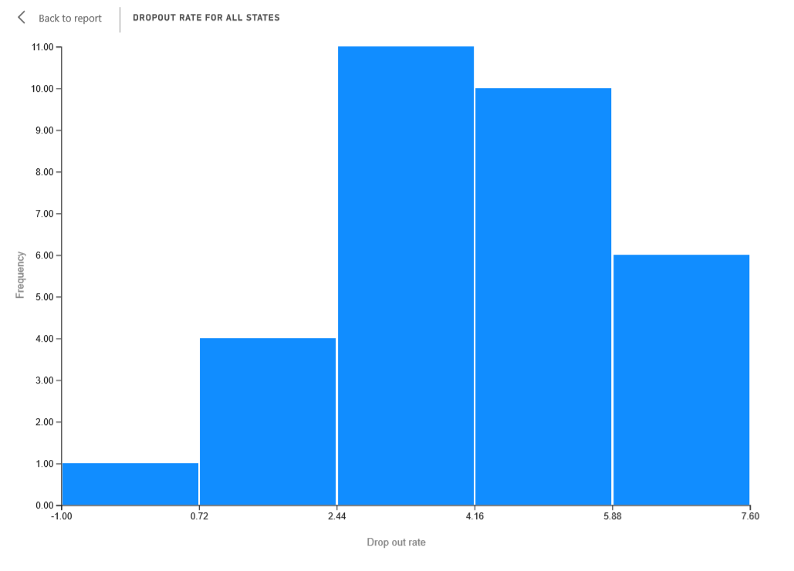
PowerBI - Histogram

Slide 11
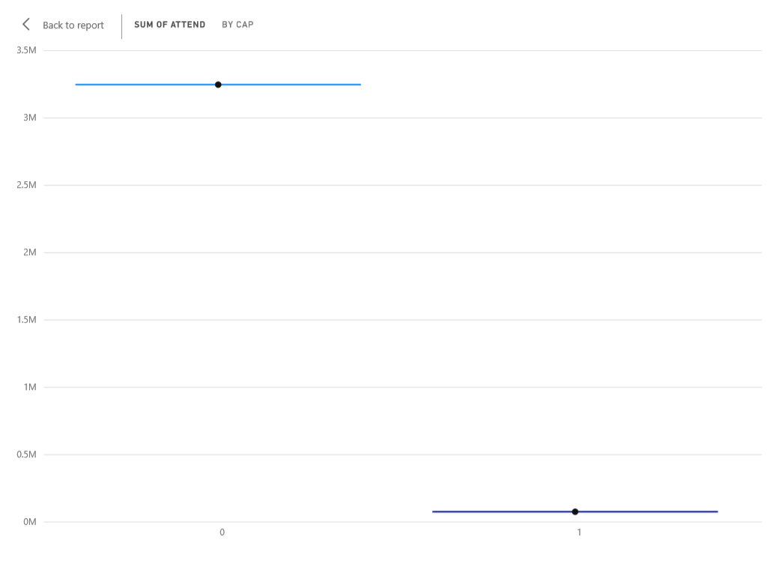
PowerBI – Box Chart
Played with this for quite a while and couldn’t get the boxes right, so submitting as is.

Slide 12
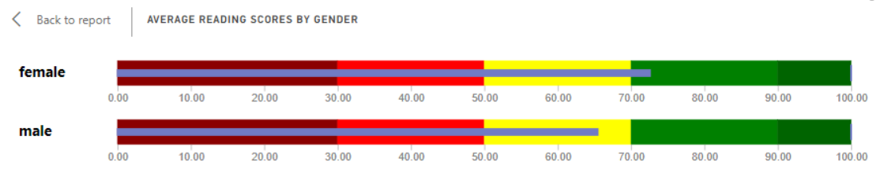
PowerBI – Bullet Chart

Slide 13
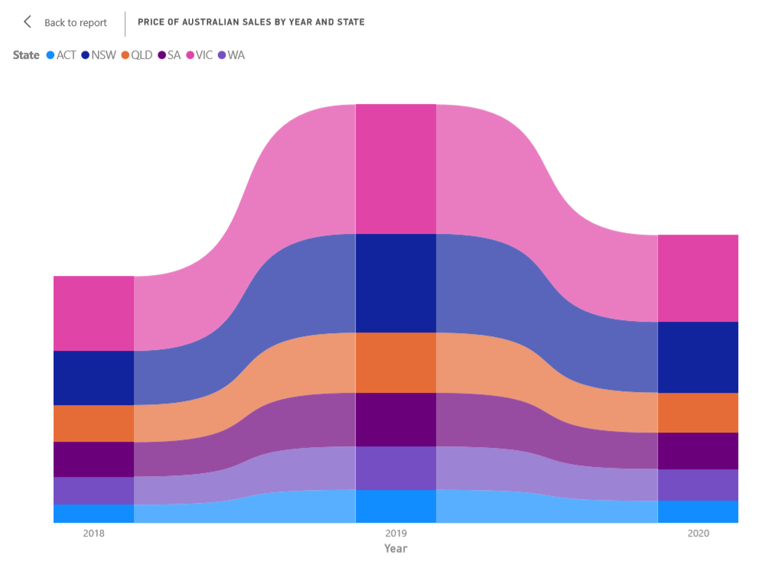
PowerBI – My choice – Ribbon Chart

Slide 14
References
Australian sales dataset found here - https://www.kaggle.com/htagholdings/aus-real-estate-sales-march-2019-to-april-2020
Python bullet chart reference - https://pbpython.com/bullet-graph.html
Python scatter plot reference - https://www.python-graph-gallery.com/131-custom-a-matplotlib-scatterplot
R histogram reference - https://www.datacamp.com/community/tutorials/make-histogram-basic-r?utm_source=adwords_ppc&utm_campaignid=1565261270&utm_adgroupid=67750485268&utm_device=c&utm_keyword=&utm_matchtype=b&utm_network=g&utm_adpostion=&utm_creative=332661264371&utm_targetid=aud-299261629574:dsa-473406586075&utm_loc_interest_ms=&utm_loc_physical_ms=9023158&gclid=Cj0KCQiA7YyCBhD_ARIsALkj54paX2AXdYCXWCLg3E2F3wKirlaiKE2cvBXHs_PVmXIEp1eQTtzYr_0aAmiCEALw_wcB

Slide 15
References continued
R boxplot reference used - https://www.statmethods.net/graphs/boxplot.html
R bullet chart reference used - https://plotly.com/r/bullet-charts/
R my choice/scatter plot upgrade reference used - http://www.sthda.com/english/wiki/ggplot2-point-shapes

